Slide 1
Backtracking Algorithm
CSE 2202: Algorithm Analysis and Design Laboratory
Most. Kaniz Fatema Isha
Md Mehrab Hossain Opi

Slide 2
Background
A backtracking algorithm is a problem-solving algorithm that uses a brute force approach for finding the desired output.
It is a general algorithm that can be used to find one or multiple solutions to some computational problems.
When a dead end is reached, the algorithm backtracks to the previous decision point and explores a different path until a solution is found or all possibilities have been exhausted.

Slide 3
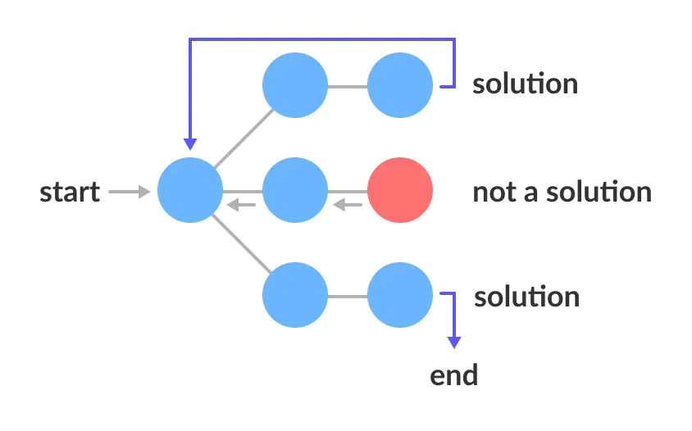
State Space Tree
A space state tree is a tree representing all the possible states (solution or nonsolution) of the problem from the root as an initial state to the leaf as a terminal state.

Slide 4
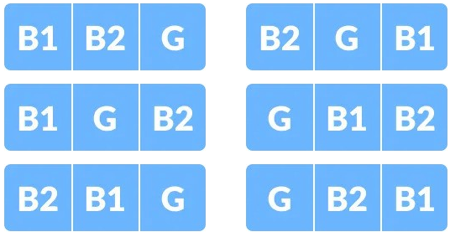
Backtrack Example
Find all the ways of arranging 2 boys and 1 girl on 3 benches.
Constraint: Girl should not be on the middle bench.
Solution:
There are 3!=6 possible combinations.

Slide 5
Backtrack Example
G
✅
B2
G
❌
B1
G
B1
✅
Start
B2
G
❌
B1
B2
G
✅
B2
✅
B1

Slide 6
Backtracking Algorithm
Backtrack(x)
if x is not a solution
return false
if x is a new solution
add to list of solutions
backtrack(expand x)

Slide 7
Applications of Backtracking Algorithm
Solving puzzles (e.g., Sudoku, crossword puzzles)
Finding the shortest path through a maze
Scheduling problems
Resource allocation problems
Network optimization problems
To find all Hamiltonian Paths present in a graph.
Constructing all permutations
Solve the N Queen problem.
The Knight's tour problem.

Slide 8
Complexity Analysis
The time complexity of a backtracking algorithm can be broken down by the following factors:
Number of Decisions: If you have n decision points, and each decision has k possibilities, the maximum number of potential solutions to check is O(k^{n}).
Pruning: If the algorithm includes effective pruning techniques, the actual number of explored nodes can be much smaller than k^{n}.

Slide 9
References
Introduction to Algorithm, 4th ed, Leiserson, Charles Eric, Ronald L. Rivest, Thomas H. Cormen, and Clifford Stein.
https://www.geeksforgeeks.org/backtracking-algorithms/
https://www.programiz.com/dsa/backtracking-algorithm
https://www.cs.usfca.edu/~galles/visualization/RecQueens.html

